Slide 1
CS162 Operating Systems and Systems Programming Lecture 10 Monitors (Finished), Scheduling 1: Concepts and Classic Policies
February 21st, 2023
Prof. John Kubiatowicz
http://cs162.eecs.Berkeley.edu

Slide 2

Recall: Bounded Buffer, 3rd cut (coke machine)
Semaphore fullSlots = 0; // Initially, no coke
Semaphore emptySlots = bufSize; // Initially, num empty slots
Semaphore mutex = 1; // No one using machine
Producer(item) { semaP(&emptySlots); // Wait until space semaP(&mutex); // Wait until machine free Enqueue(item); semaV(&mutex); semaV(&fullSlots); // Tell consumers there is // more coke }
Consumer() { semaP(&fullSlots); // Check if there’s a coke semaP(&mutex); // Wait until machine free item = Dequeue(); semaV(&mutex); semaV(&emptySlots); // tell producer need more return item; }
Critical sections using mutex protect integrity of the queue
fullSlots signals coke
emptySlots
signals space

Slide 3
Recall: Monitors and Condition Variables
Monitor: a lock and zero or more condition variables for managing concurrent access to shared data
Use of Monitors is a programming paradigm
Some languages like Java provide monitors in the language
Condition Variable: a queue of threads waiting for something inside a critical section
Key idea: allow sleeping inside critical section by atomically releasing lock at time we go to sleep
Contrast to semaphores: Can’t wait inside critical section
Operations:
Wait(&lock): Atomically release lock and go to sleep. Re-acquire lock later, before returning.
Signal(): Wake up one waiter, if any
Broadcast(): Wake up all waiters
Rule: Must hold lock when doing condition variable ops!

Slide 4
Recall: Readers/Writers Problem
W
R
R
R
Motivation: Consider a shared database
Two classes of users:
Readers – never modify database
Writers – read and modify database
Is using a single lock on the whole database sufficient?
Like to have many readers at the same time
Only one writer at a time

Slide 5
Recall: Code for a Reader
Reader() { // First check self into system acquire(&lock);
while ((AW + WW) > 0) { // Is it safe to read? WR++; // No. Writers exist cond_wait(&okToRead,&lock);// Sleep on cond var WR--; // No longer waiting }
AR++; // Now we are active! release(&lock);
// Perform actual read-only access AccessDatabase(ReadOnly);
// Now, check out of system acquire(&lock); AR--; // No longer active if (AR == 0 && WW > 0) // No other active readers cond_signal(&okToWrite);// Wake up one writer release(&lock); }
Why Release the Lock here?

Slide 6
Recall: Code for a Writer
Writer() { // First check self into system acquire(&lock);
while ((AW + AR) > 0) { // Is it safe to write? WW++; // No. Active users exist cond_wait(&okToWrite,&lock); // Sleep on cond var WW--; // No longer waiting }
AW++; // Now we are active! release(&lock);
// Perform actual read/write access AccessDatabase(ReadWrite);
// Now, check out of system acquire(&lock); AW--; // No longer active if (WW > 0){ // Give priority to writers cond_signal(&okToWrite);// Wake up one writer } else if (WR > 0) { // Otherwise, wake reader cond_broadcast(&okToRead); // Wake all readers } release(&lock); }
Why broadcast() here instead of signal()?
Why Give priority to writers?

Slide 7
Simulation of Readers/Writers Solution
Use an example to simulate the solution
Consider the following sequence of operators:
R1, R2, W1, R3
Initially: AR = 0, WR = 0, AW = 0, WW = 0

Slide 8
Simulation of Readers/Writers Solution
R1 comes along (no waiting threads)
AR = 0, WR = 0, AW = 0, WW = 0
Reader() { acquire(&lock)
while ((AW + WW) > 0) { // Is it safe to read? WR++; // No. Writers exist cond_wait(&okToRead,&lock);// Sleep on cond var WR--; // No longer waiting }
AR++; // Now we are active! release(&lock);
AccessDBase(ReadOnly);
acquire(&lock); AR--; if (AR == 0 && WW > 0) cond_signal(&okToWrite); release(&lock); }

Slide 9
Simulation of Readers/Writers Solution
R1 comes along (no waiting threads)
AR = 0, WR = 0, AW = 0, WW = 0
Reader() { acquire(&lock);
while ((AW + WW) > 0) { // Is it safe to read? WR++; // No. Writers exist cond_wait(&okToRead,&lock);// Sleep on cond var WR--; // No longer waiting }
AR++; // Now we are active! release(&lock);
AccessDBase(ReadOnly);
acquire(&lock); AR--; if (AR == 0 && WW > 0) cond_signal(&okToWrite); release(&lock); }

Slide 10
Simulation of Readers/Writers Solution
R1 comes along (no waiting threads)
AR = 1, WR = 0, AW = 0, WW = 0
Reader() { acquire(&lock);
while ((AW + WW) > 0) { // Is it safe to read? WR++; // No. Writers exist cond_wait(&okToRead,&lock);// Sleep on cond var WR--; // No longer waiting }
AR++; // Now we are active! release(&lock);
AccessDBase(ReadOnly);
acquire(&lock); AR--; if (AR == 0 && WW > 0) cond_signal(&okToWrite); release(&lock); }

Slide 11
Simulation of Readers/Writers Solution
R1 comes along (no waiting threads)
AR = 1, WR = 0, AW = 0, WW = 0
Reader() { acquire(&lock);
while ((AW + WW) > 0) { // Is it safe to read? WR++; // No. Writers exist cond_wait(&okToRead,&lock);// Sleep on cond var WR--; // No longer waiting }
AR++; // Now we are active! release(&lock);
AccessDBase(ReadOnly);
acquire(&lock); AR--; if (AR == 0 && WW > 0) cond_signal(&okToWrite); release(&lock); }
Why release the
lock here???

Slide 12
Simulation of Readers/Writers Solution
R1 accessing dbase (no other threads)
AR = 1, WR = 0, AW = 0, WW = 0
Reader() { acquire(&lock);
while ((AW + WW) > 0) { // Is it safe to read? WR++; // No. Writers exist cond_wait(&okToRead,&lock);// Sleep on cond var WR--; // No longer waiting }
AR++; // Now we are active! release(&lock);
AccessDBase(ReadOnly);
acquire(&lock); AR--; if (AR == 0 && WW > 0) cond_signal(&okToWrite); release(&lock); }

Slide 13
Simulation of Readers/Writers Solution
R2 comes along (R1 accessing dbase)
AR = 1, WR = 0, AW = 0, WW = 0
Reader() { acquire(&lock);
while ((AW + WW) > 0) { // Is it safe to read? WR++; // No. Writers exist cond_wait(&okToRead,&lock);// Sleep on cond var WR--; // No longer waiting }
AR++; // Now we are active! release(&lock);
AccessDBase(ReadOnly);
acquire(&lock); AR--; if (AR == 0 && WW > 0) cond_signal(&okToWrite); release(&lock); }

Slide 14
Simulation of Readers/Writers Solution
R2 comes along (R1 accessing dbase)
AR = 1, WR = 0, AW = 0, WW = 0
Reader() { acquire(&lock);
while ((AW + WW) > 0) { // Is it safe to read? WR++; // No. Writers exist cond_wait(&okToRead,&lock);// Sleep on cond var WR--; // No longer waiting }
AR++; // Now we are active! release(&lock);
AccessDBase(ReadOnly);
acquire(&lock); AR--; if (AR == 0 && WW > 0) cond_signal(&okToWrite); release(&lock); }

Slide 15
Simulation of Readers/Writers Solution
R2 comes along (R1 accessing dbase)
AR = 2, WR = 0, AW = 0, WW = 0
Reader() { acquire(&lock);
while ((AW + WW) > 0) { // Is it safe to read? WR++; // No. Writers exist cond_wait(&okToRead,&lock);// Sleep on cond var WR--; // No longer waiting }
AR++; // Now we are active! release(&lock);
AccessDBase(ReadOnly);
acquire(&lock); AR--; if (AR == 0 && WW > 0) cond_signal(&okToWrite); release(&lock); }

Slide 16
Simulation of Readers/Writers Solution
R2 comes along (R1 accessing dbase)
AR = 2, WR = 0, AW = 0, WW = 0
Reader() { acquire(&lock);
while ((AW + WW) > 0) { // Is it safe to read? WR++; // No. Writers exist cond_wait(&okToRead,&lock);// Sleep on cond var WR--; // No longer waiting }
AR++; // Now we are active! release(&lock);
AccessDBase(ReadOnly);
acquire(&lock); AR--; if (AR == 0 && WW > 0) cond_signal(&okToWrite); release(&lock); }

Slide 17
Simulation of Readers/Writers Solution
R1 and R2 accessing dbase
AR = 2, WR = 0, AW = 0, WW = 0
Reader() { acquire(&lock);
while ((AW + WW) > 0) { // Is it safe to read? WR++; // No. Writers exist cond_wait(&okToRead,&lock);// Sleep on cond var WR--; // No longer waiting }
AR++; // Now we are active! release(&lock);
AccessDBase(ReadOnly);
acquire(&lock); AR--; if (AR == 0 && WW > 0) cond_signal(&okToWrite); release(&lock); }
Assume readers take a while to access database
Situation: Locks released, only AR is non-zero

Slide 18
Simulation of Readers/Writers Solution
W1 comes along (R1 and R2 are still accessing dbase)
AR = 2, WR = 0, AW = 0, WW = 0
Writer() { acquire(&lock);
while ((AW + AR) > 0) { // Is it safe to write? WW++; // No. Active users exist cond_wait(&okToWrite,&lock);// Sleep on cond var WW--; // No longer waiting }
AW++; release(&lock);
AccessDBase(ReadWrite);
acquire(&lock); AW--; if (WW > 0){ cond_signal(&okToWrite); } else if (WR > 0) { cond_broadcast(&okToRead); } release(&lock); }

Slide 19
Simulation of Readers/Writers Solution
W1 comes along (R1 and R2 are still accessing dbase)
AR = 2, WR = 0, AW = 0, WW = 0
Writer() { acquire(&lock);
while ((AW + AR) > 0) { // Is it safe to write? WW++; // No. Active users exist cond_wait(&okToWrite,&lock);// Sleep on cond var WW--; // No longer waiting }
AW++; release(&lock);
AccessDBase(ReadWrite);
acquire(&lock); AW--; if (WW > 0){ cond_signal(&okToWrite); } else if (WR > 0) { cond_broadcast(&okToRead); } release(&lock); }

Slide 20
Simulation of Readers/Writers Solution
W1 comes along (R1 and R2 are still accessing dbase)
AR = 2, WR = 0, AW = 0, WW = 1
Writer() { acquire(&lock);
while ((AW + AR) > 0) { // Is it safe to write? WW++; // No. Active users exist cond_wait(&okToWrite,&lock);// Sleep on cond var WW--; // No longer waiting }
AW++; release(&lock);
AccessDBase(ReadWrite);
acquire(&lock); AW--; if (WW > 0){ cond_signal(&okToWrite); } else if (WR > 0) { cond_broadcast(&okToRead); } release(&lock); }
W1 cannot start because of readers

Slide 21
Simulation of Readers/Writers Solution
R3 comes along (R1 and R2 accessing dbase, W1 waiting)
AR = 2, WR = 0, AW = 0, WW = 1
Reader() { acquire(&lock);
while ((AW + WW) > 0) { // Is it safe to read? WR++; // No. Writers exist cond_wait(&okToRead,&lock);// Sleep on cond var WR--; // No longer waiting }
AR++; // Now we are active! release(&lock);
AccessDBase(ReadOnly);
acquire(&lock); AR--; if (AR == 0 && WW > 0) cond_signal(&okToWrite); release(&lock); }

Slide 22
Simulation of Readers/Writers Solution
R3 comes along (R1 and R2 accessing dbase, W1 waiting)
AR = 2, WR = 0, AW = 0, WW = 1
Reader() { acquire(&lock);
while ((AW + WW) > 0) { // Is it safe to read? WR++; // No. Writers exist cond_wait(&okToRead,&lock);// Sleep on cond var WR--; // No longer waiting }
AR++; // Now we are active! release(&lock);
AccessDBase(ReadOnly);
acquire(&lock); AR--; if (AR == 0 && WW > 0) cond_signal(&okToWrite); release(&lock); }

Slide 23
Simulation of Readers/Writers Solution
R3 comes along (R1 and R2 accessing dbase, W1 waiting)
AR = 2, WR = 1, AW = 0, WW = 1
Reader() { acquire(&lock);
while ((AW + WW) > 0) { // Is it safe to read? WR++; // No. Writers exist cond_wait(&okToRead,&lock);// Sleep on cond var WR--; // No longer waiting }
AR++; // Now we are active! lock.release();
AccessDBase(ReadOnly);
acquire(&lock); AR--; if (AR == 0 && WW > 0) cond_signal(&okToWrite); release(&lock); }

Slide 24
Simulation of Readers/Writers Solution
R3 comes along (R1, R2 accessing dbase, W1 waiting)
AR = 2, WR = 1, AW = 0, WW = 1
Reader() { acquire(&lock);
while ((AW + WW) > 0) { // Is it safe to read? WR++; // No. Writers exist cond_wait(&okToRead,&lock);// Sleep on cond var WR--; // No longer waiting }
AR++; // Now we are active! release(&lock);
AccessDBase(ReadOnly);
acquire(&lock); AR--; if (AR == 0 && WW > 0) cond_signal(&okToWrite); release(&lock); }
R3 cannot start because of writers (both AW & WW)

Slide 25
Simulation of Readers/Writers Solution
R1 and R2 accessing dbase, W1 and R3 waiting
AR = 2, WR = 1, AW = 0, WW = 1
Reader() { acquire(&lock);
while ((AW + WW) > 0) { // Is it safe to read? WR++; // No. Writers exist cond_wait(&okToRead,&lock);// Sleep on cond var WR--; // No longer waiting }
AR++; // Now we are active! release(&lock);
AccessDBase(ReadOnly);
acquire(&lock); AR--; if (AR == 0 && WW > 0) cond_signal(&okToWrite); release(&lock); }
Status:
R1 and R2 still reading
W1 and R3 waiting on okToWrite and okToRead, respectively

Slide 26
Simulation of Readers/Writers Solution
R2 finishes (R1 accessing dbase, W1 and R3 waiting)
AR = 2, WR = 1, AW = 0, WW = 1
Reader() { acquire(&lock);
while ((AW + WW) > 0) { // Is it safe to read? WR++; // No. Writers exist cond_wait(&okToRead,&lock);// Sleep on cond var WR--; // No longer waiting }
AR++; // Now we are active! release(&lock);
AccessDBase(ReadOnly);
acquire(&lock); AR--; if (AR == 0 && WW > 0) cond_signal(&okToWrite); release(&lock); }

Slide 27
Simulation of Readers/Writers Solution
R2 finishes (R1 accessing dbase, W1 and R3 waiting)
AR = 1, WR = 1, AW = 0, WW = 1
Reader() { acquire(&lock);
while ((AW + WW) > 0) { // Is it safe to read? WR++; // No. Writers exist cond_wait(&okToRead,&lock);// Sleep on cond var WR--; // No longer waiting }
AR++; // Now we are active! release(&lock);
AccessDBase(ReadOnly);
acquire(&lock); AR--; if (AR == 0 && WW > 0) cond_signal(&okToWrite); release(&lock); }

Slide 28
Simulation of Readers/Writers Solution
R2 finishes (R1 accessing dbase, W1 and R3 waiting)
AR = 1, WR = 1, AW = 0, WW = 1
Reader() { acquire(&lock);
while ((AW + WW) > 0) { // Is it safe to read? WR++; // No. Writers exist cond_wait(&okToRead,&lock);// Sleep on cond var WR--; // No longer waiting }
AR++; // Now we are active! release(&lock);
AccessDBase(ReadOnly);
acquire(&lock); AR--; if (AR == 0 && WW > 0) cond_signal(&okToWrite); release(&lock); }

Slide 29
Simulation of Readers/Writers Solution
R2 finishes (R1 accessing dbase, W1 and R3 waiting)
AR = 1, WR = 1, AW = 0, WW = 1
Reader() { acquire(&lock);
while ((AW + WW) > 0) { // Is it safe to read? WR++; // No. Writers exist cond_wait(&okToRead,&lock);// Sleep on cond var WR--; // No longer waiting }
AR++; // Now we are active! release(&lock);
AccessDBase(ReadOnly);
acquire(&lock); AR--; if (AR == 0 && WW > 0) cond_signal(&okToWrite); release(&lock); }

Slide 30
Simulation of Readers/Writers Solution
R1 finishes (W1 and R3 waiting)
AR = 1, WR = 1, AW = 0, WW = 1
Reader() { acquire(&lock);
while ((AW + WW) > 0) { // Is it safe to read? WR++; // No. Writers exist cond_wait(&okToRead,&lock);// Sleep on cond var WR--; // No longer waiting }
AR++; // Now we are active! release(&lock);
AccessDBase(ReadOnly);
acquire(&lock); AR--; if (AR == 0 && WW > 0) cond_signal(&okToWrite); release(&lock); }

Slide 31
Simulation of Readers/Writers Solution
R1 finishes (W1, R3 waiting)
AR = 0, WR = 1, AW = 0, WW = 1
Reader() { acquire(&lock);
while ((AW + WW) > 0) { // Is it safe to read? WR++; // No. Writers exist cond_wait(&okToRead,&lock);// Sleep on cond var WR--; // No longer waiting }
AR++; // Now we are active! release(&lock);
AccessDBase(ReadOnly);
acquire(&lock); AR--; if (AR == 0 && WW > 0) cond_signal(&okToWrite); release(&lock); }

Slide 32
Simulation of Readers/Writers Solution
R1 finishes (W1, R3 waiting)
AR = 0, WR = 1, AW = 0, WW = 1
Reader() { acquire(&lock);
while ((AW + WW) > 0) { // Is it safe to read? WR++; // No. Writers exist cond_wait(&okToRead,&lock);// Sleep on cond var WR--; // No longer waiting }
AR++; // Now we are active! release(&lock);
AccessDBase(ReadOnly);
acquire(&lock); AR--; if (AR == 0 && WW > 0) cond_signal(&okToWrite); release(&lock); }

Slide 33
Simulation of Readers/Writers Solution
R1 signals a writer (W1 and R3 waiting)
AR = 0, WR = 1, AW = 0, WW = 1
Reader() { acquire(&lock);
while ((AW + WW) > 0) { // Is it safe to read? WR++; // No. Writers exist cond_wait(&okToRead,&lock);// Sleep on cond var WR--; // No longer waiting }
AR++; // Now we are active! release(&lock);
AccessDBase(ReadOnly);
acquire(&lock); AR--; if (AR == 0 && WW > 0) cond_signal(&okToWrite); release(&lock); }
All readers done,
Signal writer W1

Slide 34
Simulation of Readers/Writers Solution
W1 gets signal (R3 still waiting)
AR = 0, WR = 1, AW = 0, WW = 1
Writer() { acquire(&lock);
while ((AW + AR) > 0) { // Is it safe to write? WW++; // No. Active users exist cond_wait(&okToWrite,&lock);// Sleep on cond var WW--; // No longer waiting }
AW++; release(&lock);
AccessDBase(ReadWrite);
acquire(&lock); AW--; if (WW > 0){ cond_signal(&okToWrite); } else if (WR > 0) { cond_broadcast(&okToRead); } release(&lock); }
Receive signal from R1

Slide 35
Simulation of Readers/Writers Solution
W1 gets signal (R3 still waiting)
AR = 0, WR = 1, AW = 0, WW = 0
Writer() { acquire(&lock);
while ((AW + AR) > 0) { // Is it safe to write? WW++; // No. Active users exist cond_wait(&okToWrite,&lock);// Sleep on cond var WW--; // No longer waiting }
AW++; release(&lock);
AccessDBase(ReadWrite);
acquire(&lock); AW--; if (WW > 0){ cond_signal(&okToWrite); } else if (WR > 0) { cond_broadcast(&okToRead); } release(&lock); }

Slide 36
Simulation of Readers/Writers Solution
W1 gets signal (R3 still waiting)
AR = 0, WR = 1, AW = 1, WW = 0
Writer() { acquire(&lock);
while ((AW + AR) > 0) { // Is it safe to write? WW++; // No. Active users exist cond_wait(&okToWrite,&lock);// Sleep on cond var WW--; // No longer waiting }
AW++; release(&lock);
AccessDBase(ReadWrite);
acquire(&lock); AW--; if (WW > 0){ cond_signal(&okToWrite); } else if (WR > 0) { cond_broadcast(&okToRead); } release(&lock); }

Slide 37
Simulation of Readers/Writers Solution
W1 accessing dbase (R3 still waiting)
AR = 0, WR = 1, AW = 1, WW = 0
Writer() { acquire(&lock);
while ((AW + AR) > 0) { // Is it safe to write? WW++; // No. Active users exist cond_wait(&okToWrite,&lock);// Sleep on cond var WW--; // No longer waiting }
AW++; release(&lock);
AccessDBase(ReadWrite);
acquire(&lock); AW--; if (WW > 0){ cond_signal(&okToWrite); } else if (WR > 0) { cond_broadcast(&okToRead); } release(&lock); }

Slide 38
Simulation of Readers/Writers Solution
W1 finishes (R3 still waiting)
AR = 0, WR = 1, AW = 1, WW = 0
Writer() { acquire(&lock);
while ((AW + AR) > 0) { // Is it safe to write? WW++; // No. Active users exist cond_wait(&okToWrite,&lock);// Sleep on cond var WW--; // No longer waiting }
AW++; release(&lock);
AccessDBase(ReadWrite);
acquire(&lock); AW--; if (WW > 0){ cond_signal(&okToWrite); } else if (WR > 0) { cond_broadcast(&okToRead); } release(&lock); }

Slide 39
Simulation of Readers/Writers Solution
W1 finishes (R3 still waiting)
AR = 0, WR = 1, AW = 0, WW = 0
Writer() { acquire(&lock);
while ((AW + AR) > 0) { // Is it safe to write? WW++; // No. Active users exist cond_wait(&okToWrite,&lock);// Sleep on cond var WW--; // No longer waiting }
AW++; release(&lock);
AccessDBase(ReadWrite);
acquire(&lock); AW--; if (WW > 0){ cond_signal(&okToWrite); } else if (WR > 0) { cond_broadcast(&okToRead); } release(&lock); }

Slide 40
Simulation of Readers/Writers Solution
W1 finishes (R3 still waiting)
AR = 0, WR = 1, AW = 0, WW = 0
Writer() { acquire(&lock);
while ((AW + AR) > 0) { // Is it safe to write? WW++; // No. Active users exist cond_wait(&okToWrite,&lock);// Sleep on cond var WW--; // No longer waiting }
AW++; release(&lock);
AccessDBase(ReadWrite);
acquire(&lock); AW--; if (WW > 0){ cond_signal(&okToWrite); } else if (WR > 0) { cond_broadcast(&okToRead); } release(&lock); }

Slide 41
Simulation of Readers/Writers Solution
W1 signaling readers (R3 still waiting)
AR = 0, WR = 1, AW = 0, WW = 0
Writer() { acquire(&lock);
while ((AW + AR) > 0) { // Is it safe to write? WW++; // No. Active users exist cond_wait(&okToWrite,&lock);// Sleep on cond var WW--; // No longer waiting }
AW++; release(&lock);
AccessDBase(ReadWrite);
acquire(&lock); AW--; if (WW > 0){ cond_signal(&okToWrite); } else if (WR > 0) { cond_broadcast(&okToRead); } release(&lock); }
No waiting writers,
Signal reader R3

Slide 42
Simulation of Readers/Writers Solution
R3 gets signal (no waiting threads)
AR = 0, WR = 1, AW = 0, WW = 0
Reader() { acquire(&lock);
while ((AW + WW) > 0) { // Is it safe to read? WR++; // No. Writers exist cond_wait(&okToRead,&lock);// Sleep on cond var WR--; // No longer waiting }
AR++; // Now we are active! release(&lock);
AccessDBase(ReadOnly);
acquire(&lock); AR--; if (AR == 0 && WW > 0) cond_signal(&okToWrite); release(&lock); }
Receive signal from W1

Slide 43
Simulation of Readers/Writers Solution
R3 gets signal (no waiting threads)
AR = 0, WR = 0, AW = 0, WW = 0
Reader() { acquire(&lock);
while ((AW + WW) > 0) { // Is it safe to read? WR++; // No. Writers exist cond_wait(&okToRead,&lock);// Sleep on cond var WR--; // No longer waiting }
AR++; // Now we are active! release(&lock);
AccessDBase(ReadOnly);
acquire(&lock); AR--; if (AR == 0 && WW > 0) cond_signal(&okToWrite); release(&lock); }

Slide 44
Simulation of Readers/Writers Solution
R3 accessing dbase (no waiting threads)
AR = 1, WR = 0, AW = 0, WW = 0
Reader() { acquire(&lock);
while ((AW + WW) > 0) { // Is it safe to read? WR++; // No. Writers exist cond_wait(&okToRead,&lock);// Sleep on cond var WR--; // No longer waiting }
AR++; // Now we are active! release(&lock);
AccessDBase(ReadOnly);
acquire(&lock); AR--; if (AR == 0 && WW > 0) cond_signal(&okToWrite); release(&lock); }

Slide 45
Simulation of Readers/Writers Solution
R3 finishes (no waiting threads)
AR = 1, WR = 0, AW = 0, WW = 0
Reader() { acquire(&lock);
while ((AW + WW) > 0) { // Is it safe to read? WR++; // No. Writers exist cond_wait(&okToRead,&lock);// Sleep on cond var WR--; // No longer waiting }
AR++; // Now we are active! release(&lock);
AccessDBase(ReadOnly);
acquire(&lock); AR--; if (AR == 0 && WW > 0) cond_signal(&okToWrite); release(&lock); }

Slide 46
Simulation of Readers/Writers Solution
R3 finishes (no waiting threads)
AR = 0, WR = 0, AW = 0, WW = 0
Reader() { acquire(&lock);
while ((AW + WW) > 0) { // Is it safe to read? WR++; // No. Writers exist cond_wait(&okToRead,&lock);// Sleep on cond var WR--; // No longer waiting }
AR++; // Now we are active! release(&lock);
AccessDBase(ReadOnly);
acquire(&lock); AR--; if (AR == 0 && WW > 0) cond_signal(&okToWrite); release(&lock); }
All DONE!
DBase is Idle

Slide 47
Questions
Can readers starve? Consider Reader() entry code:
while ((AW + WW) > 0) { // Is it safe to read? WR++; // No. Writers exist cond_wait(&okToRead,&lock);// Sleep on cond var WR--; // No longer waiting }
AR++; // Now we are active!
What if we erase the condition check in Reader exit?
AR--; // No longer active if (AR == 0 && WW > 0) // No other active readers cond_signal(&okToWrite);// Wake up one writer
Further, what if we turn the signal() into broadcast()
AR--; // No longer active cond_broadcast(&okToWrite); // Wake up sleepers
Finally, what if we use only one condition variable (call it “okContinue”) instead of two separate ones?
Both readers and writers sleep on this variable
Must use broadcast() instead of signal()

Slide 48
Use of Single CV: okContinue
Reader() { // check into system acquire(&lock);
while ((AW + WW) > 0) { WR++; cond_wait(&okContinue,&lock); WR--; }
AR++; release(&lock);
// read-only access AccessDbase(ReadOnly);
// check out of system acquire(&lock); AR--; if (AR == 0 && WW > 0) cond_signal(&okContinue); release(&lock); }
Writer() { // check into system acquire(&lock);
while ((AW + AR) > 0) { WW++; cond_wait(&okContinue,&lock); WW--; }
AW++; release(&lock);
// read/write access AccessDbase(ReadWrite);
// check out of system acquire(&lock); AW--; if (WW > 0){ cond_signal(&okContinue); } else if (WR > 0) { cond_broadcast(&okContinue); } release(&lock); }
What if we turn okToWrite and okToRead into okContinue (i.e. use only one condition variable instead of two)?

Slide 49
Use of Single CV: okContinue
Reader() { // check into system acquire(&lock);
while ((AW + WW) > 0) { WR++; cond_wait(&okContinue,&lock); WR--; }
AR++; release(&lock);
// read-only access AccessDbase(ReadOnly);
// check out of system acquire(&lock); AR--; if (AR == 0 && WW > 0) cond_signal(&okContinue); release(&lock); }
Writer() { // check into system acquire(&lock);
while ((AW + AR) > 0) { WW++; cond_wait(&okContinue,&lock); WW--; }
AW++; release(&lock);
// read/write access AccessDbase(ReadWrite);
// check out of system acquire(&lock); AW--; if (WW > 0){ cond_signal(&okContinue); } else if (WR > 0) { cond_broadcast(&okContinue); } release(&lock); }
Consider this scenario:
R1 arrives
W1, R2 arrive while R1 still reading → W1 and R2 wait for R1 to finish
Assume R1’s signal is delivered to R2 (not W1)

Slide 50
Use of Single CV: okContinue
Reader() { // check into system acquire(&lock);
while ((AW + WW) > 0) { WR++; cond_wait(&okContinue,&lock); WR--; }
AR++; release(&lock);
// read-only access AccessDbase(ReadOnly);
// check out of system acquire(&lock); AR--; if (AR == 0 && WW > 0) cond_broadcast(&okContinue); release(&lock); }
Writer() { // check into system acquire(&lock);
while ((AW + AR) > 0) { WW++; cond_wait(&okContinue,&lock); WW--; }
AW++; release(&lock);
// read/write access AccessDbase(ReadWrite);
// check out of system acquire(&lock); AW--; if (WW > 0 || WR > 0){ cond_broadcast(&okContinue); } release(&lock); }
Need to change to broadcast()!
Must broadcast() to sort things out!

Slide 51
Can we construct Monitors from Semaphores?
Locking aspect is easy: Just use a mutex
Can we implement condition variables this way?
Wait(Semaphore *thesema) { semaP(thesema); }
Signal(Semaphore *thesema) { semaV(thesema); }
Doesn’t work: Wait() may sleep with lock held
Does this work better?
Wait(Lock *thelock, Semaphore *thesema) { release(thelock); semaP(thesema); acquire(thelock); } Signal(Semaphore *thesema) {
semaV(thesema); }
No: Condition vars have no history, semaphores have history:
What if thread signals and no one is waiting? NO-OP
What if thread later waits? Thread Waits
What if thread V’s and noone is waiting? Increment
What if thread later does P? Decrement and continue

Slide 52
Construction of Monitors from Semaphores (con’t)
Problem with previous try:
P and V are commutative – result is the same no matter what order they occur
Condition variables are NOT commutative
Does this fix the problem?
Wait(Lock *thelock, Semaphore *thesema) { release(thelock); semaP(thesema); acquire(thelock); } Signal(Semaphore *thesema) { if semaphore queue is not empty semaV(thesema); }
Not legal to look at contents of semaphore queue
There is a race condition – signaler can slip in after lock release and before waiter executes semaphore.P()
It is actually possible to do this correctly
Complex solution for Hoare scheduling in book
Can you come up with simpler Mesa-scheduled solution?

Slide 53
Administrivia
Still grading Midterm 1 (Sorry)
Finishing soon!
Solutions also will be up soon.
Homework #2 due Thursday
Professor Kubi’s office hours changed slightly:
Monday 2-3 (same), Wednesday 3-4 (different)
673 Soda Hall

Slide 54
C-Language Support for Synchronization
C language: Pretty straightforward synchronization
Just make sure you know all the code paths out of a critical section
int Rtn() { acquire(&lock); … if (exception) { release(&lock); return errReturnCode; } … release(&lock); return OK; }
Watch out for setjmp/longjmp!
Can cause a non-local jump out of procedure
In example, procedure E calls longjmp, poping stack back to procedure B
If Procedure C had lock.acquire, problem!
Proc A
Proc B
Calls setjmp
Stack growth
Proc C
acquire(&lock)
Proc D
Proc E
Calls longjmp

Slide 55
Concurrency and Synchronization in C
Harder with more locks
void Rtn() { lock1.acquire(); … if (error) { lock1.release(); return; }
…
lock2.acquire();
…
if (error) {
lock2.release()
lock1.release();
return;
}
…
lock2.release();
lock1.release(); }
Is goto a solution???
void Rtn() { lock1.acquire(); … if (error) { goto release_lock1_and_return; }
…
lock2.acquire();
…
if (error) {
goto release_both_and_return;
}
…
release_both_and_return:
lock2.release();
release_lock1_and_return:
lock1.release(); }

Slide 56
C++ Language Support for Synchronization
Languages with exceptions like C++
Languages that support exceptions are problematic (easy to make a non-local exit without releasing lock)
Consider:
void Rtn() { lock.acquire(); … DoFoo(); … lock.release(); } void DoFoo() { … if (exception) throw errException; … }
Notice that an exception in DoFoo() will exit without releasing the lock!

Slide 57
C++ Language Support for Synchronization (con’t)
Must catch all exceptions in critical sections
Catch exceptions, release lock, and re-throw exception: void Rtn() { lock.acquire(); try { … DoFoo(); … } catch (…) { // catch exception lock.release(); // release lock throw; // re-throw the exception } lock.release(); } void DoFoo() { … if (exception) throw errException; … }

Slide 58
Much better: C++ Lock Guards
#include <mutex>
int global_i = 0;
std::mutex global_mutex;
void safe_increment() {
std::lock_guard<std::mutex> lock(global_mutex);
…
global_i++;
// Mutex released when ‘lock’ goes out of scope
}

Slide 59
Python with Keyword
More versatile than we show here (can be used to close files, database connections, etc.)
lock = threading.Lock()
…
with lock: # Automatically calls acquire()
some_var += 1
…
# release() called however we leave block

Slide 60
Java synchronized Keyword
Every Java object has an associated lock:
Lock is acquired on entry and released on exit from a synchronized method
Lock is properly released if exception occurs inside a synchronized method
Mutex execution of synchronized methods (beware deadlock)
class Account { private int balance; // object constructor public Account (int initialBalance) { balance = initialBalance; } public synchronized int getBalance() { return balance; } public synchronized void deposit(int amount) { balance += amount; } }

Slide 61
Java Support for Monitors
Along with a lock, every object has a single condition variable associated with it
To wait inside a synchronized method:
void wait();
void wait(long timeout);
To signal while in a synchronized method:
void notify();
void notifyAll();

Slide 62
Goal for Today
if ( readyThreads(TCBs) ) {
nextTCB = selectThread(TCBs);
run( nextTCB );
} else {
run_idle_thread();
}
Discussion of Scheduling:
Which thread should run on the CPU next?
Scheduling goals, policies
Look at a number of different schedulers

Slide 63
Recall: What Do the Stacks Look Like?
Consider the following code blocks:
proc A() {
B();
}
proc B() {
while(TRUE) {
yield();
}
}
Suppose we have 2 threads:
Threads S and T
Thread S
Thread T
A
A
B(while)
B(while)
Stack growth
yield
yield
run_new_thread
run_new_thread
switch
switch
Thread S's switch returns to Thread T's (and vice versa)

Slide 64
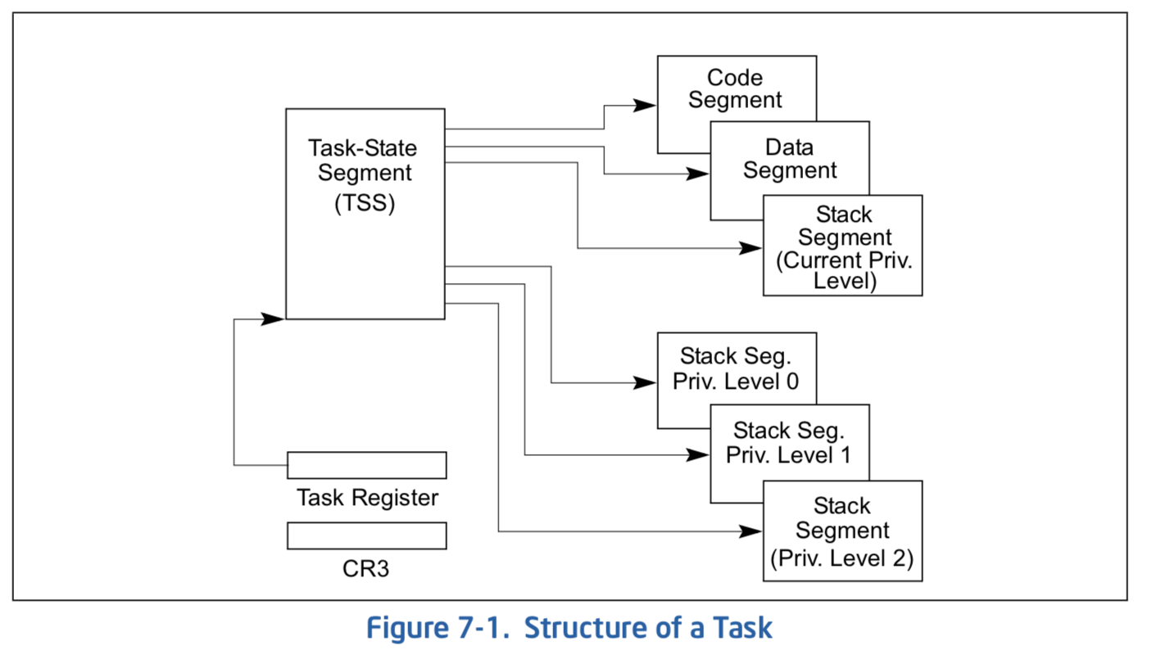
Hardware context switch support in x86
Syscall/Intr (U → K)
PL 3 → 0;
TSS ← EFLAGS, CS:EIP;
SS:ESP ← k-thread stack (TSS PL 0);
push (old) SS:ESP onto (new) k-stack
push (old) eflags, cs:eip, <err>
CS:EIP ← <k target handler>
Then
Handler saves other regs, etc
Does all its works, possibly choosing other threads, changing PTBR (CR3)
kernel thread has set up user GPRs
iret (K → U)
PL 0 → 3;
Eflags, CS:EIP ← popped off k-stack
SS:ESP ← popped off k-stack
pg 2,942 of 4,922 of x86 reference manual
Pintos: tss.c, intr-stubs.S

Slide 65
Pintos: Kernel Crossing on Syscall or Interrupt
Time
user
stack
user
code
cs:eip
cs:eip
cs:eip
cs:eip
cs:eip
ss:esp
ss:esp
ss:esp
ss:esp
ss:esp
PTBR
PTBR
PTBR
PTBR
PTBR
cs:eip
cs:eip
cs:eip
ss:esp
ss:esp
ss:esp
ready to resume
kernel
code
processing
saves
…
iret
syscall / interrupt
TCB
TCB
TCB
TCB
TCB
kernel
thread
stack

Slide 66
Pintos: Context Switch – Scheduling
Time
user
stack
user’
stack
user
code
cs:eip
cs:eip
cs:eip
Schedule
cs:eip’
cs:eip’
ss:esp
ss:esp
ss:esp
ss:esp’
ss:esp’
PTBR
PTBR
PTBR
PTBR’
PTBR’
cs:eip
cs:eip
cs:eip’
ss:esp
ss:esp
ss:esp’
ready to resume
kernel
code
processing
saves
…
iret
syscall / interrupt
TCB
TCB
TCB
TCB
TCB
kernel
thread
stack
switch kernel threads
Pintos: switch.S

Slide 67
MT Kernel 1T Process ala Pintos/x86
code
data
magic #
magic #
list
list
priority
priority
stack
Kernel
status
tid
stack
User
status
tid
code
code
data
data
heap
***
heap
PC
IP
User
stack
User
stack
SP
K SP
Proc Regs
PL: #
Each user process/thread associated with a kernel thread, described by a 4KB page object containing TCB and kernel stack for the kernel thread
Notes:
See https://web.stanford.edu/class/cs140/projects/pintos/pintos_6.html
Always set to THREAD_MAGIC, which is just an arbitrary number defined in threads/thread.c, and used to detect stack overflow. thread_current() checks that the magic member of the running thread's struct thread is set to THREAD_MAGIC. Stack overflow tends to change this value, triggering the assertion. For greatest benefit, as you add members to struct thread, leave magic at the end. (see

Slide 68
In User thread, w/ Kernel thread waiting
code
data
magic #
magic #
list
list
priority
priority
stack
Kernel
status
tid
stack
User
status
tid
code
code
data
data
heap
***
heap
IP
User
stack
User
stack
SP
K SP
Proc Regs
PL: 3
x86 CPU holds interrupt SP in register
During user thread execution, associated kernel thread is “standing by”

Slide 69
In Kernel Thread: No User Component
code
data
magic #
list
priority
Kernel
stack
User
status
tid
code
code
data
data
heap
***
heap
IP
User
stack
User
stack
SP
K SP
Proc Regs
PL: 0
Kernel threads execute with small stack in thread structure
Pure kernel threads have no corresponding user-mode thread

Slide 70
User → Kernel (exceptions, syscalls)
code
data
magic #
list
priority
Kernel
stack
User
status
tid
code
code
data
data
heap
***
heap
IP
User
stack
User
stack
SP
K SP
Proc Regs
PL: 0
Mechanism to resume k-thread goes through interrupt vector

Slide 71
Kernel → User
code
data
magic #
magic #
list
list
priority
priority
stack
Kernel
status
tid
stack
User
status
tid
code
code
data
data
heap
***
heap
IP
User
stack
User
stack
SP
K SP
Proc Regs
PL: 3
Interrupt return (iret) restores user stack, IP, and PL

Slide 72
Pintos Interrupt Processing
intrNN_stub()
Wrapper for generic handler
***
0
intr_entry:
save regs as frame
set up kernel env.
call intr_handler
intr_exit:
restore regs
iret
push 0x20 (int #)
jmp intr_entry
0x20
push 0x21 (int #)
jmp intr_entry
***
255
Hardware interrupt vector
stubs.S

Slide 73
User → Kernel via interrupt vector
0
magic #
list
priority
stack
Kernel
status
tid
User
code
code
255
intr vector
data
data
heap
***
heap
IP
User
stack
User
stack
SP
K SP
Proc Regs
PL: 3
Interrupt transfers control through the Interrupt Vector (IDT in x86)
iret restores user stack and priority level (PL)

Slide 74
Switch to Kernel Thread for Process
code
data
magic #
list
priority
Kernel
stack
User
status
tid
code
code
data
data
heap
***
heap
IP
User
stack
User
stack
SP
K SP
Proc Regs
PL: 0

Slide 75
Pintos Interrupt Processing
interrupt.c
Wrapper for generic handler
Intr_handler(*frame)
- classify
- dispatch
- ack IRQ
- maybe thread yield
intrNN_stub()
0
***
intr_entry:
save regs as frame
set up kernel env.
call intr_handler
intr_exit:
restore regs
iret
push 0x20 (int #)
jmp intr_entry
0x20
push 0x21 (int #)
jmp intr_entry
timer_intr(*frame)
tick++
thread_tick()
0
***
255
0x20
timer.c
Hardware interrupt vector
stubs.S
Pintos intr_handlers

Slide 76
Timer may trigger thread switch
thread_tick
Updates thread counters
If quanta exhausted, sets yield flag
thread_yield
On path to rtn from interrupt
Sets current thread back to READY
Pushes it back on ready_list
Calls schedule to select next thread to run upon iret
Schedule
Selects next thread to run
Calls switch_threads to change regs to point to stack for thread to resume
Sets its status to RUNNING
If user thread, activates the process
Returns back to intr_handler

Slide 77
Thread Switch (switch.S)
code
data
magic #
list
priority
Kernel
stack
User
status
tid
code
code
data
data
heap
***
heap
IP
User
stack
User
stack
SP
K SP
Proc Regs
PL: 0
switch_threads: save regs on current small stack, change SP, return from destination threads call to switch_threads

Slide 78
Pintos Return from Processing
interrupt.c
Wrapper for generic handler
Intr_handler(*frame)
- classify
- dispatch
- ack IRQ
- maybe thread yield
intrNN_stub()
0
***
intr_entry:
save regs as frame
set up kernel env.
call intr_handler
intr_exit:
restore regs
iret
push 0x20 (int #)
jmp intr_entry
0x20
push 0x20 (int #)
jmp intr_entry
timer_intr(*frame)
tick++
thread_tick()
0
***
255
0x20
timer.c
Hardware interrupt vector
Hardware interrupt vector
stubs.S
thread_yield()
- schedule
Resume Some Thread
Pintos intr_handlers
schedule()
- switch

Slide 79
Kernel → Different User Thread
code
data
magic #
magic #
list
list
priority
priority
stack
Kernel
status
stack
tid
status
User
tid
code
code
data
data
heap
***
heap
IP
User
stack
User
stack
SP
K SP
Proc Regs
PL: 3
iret restores user stack and priority level (PL)

Slide 80
Famous Quote WRT Scheduling: Dennis Richie
Dennis Richie, Unix V6, slp.c:
“If the new process paused because it was swapped out, set the stack level to the last call to savu(u_ssav). This means that the return which is executed immediately after the call to aretu actually returns from the last routine which did the savu.”
“You are not expected to understand this.”
Source: Dennis Ritchie, Unix V6 slp.c (context-switching code) as per The Unix Heritage Society(tuhs.org); gif by Eddie Koehler.
Included by Ali R. Butt in CS3204 from Virginia Tech

Slide 81
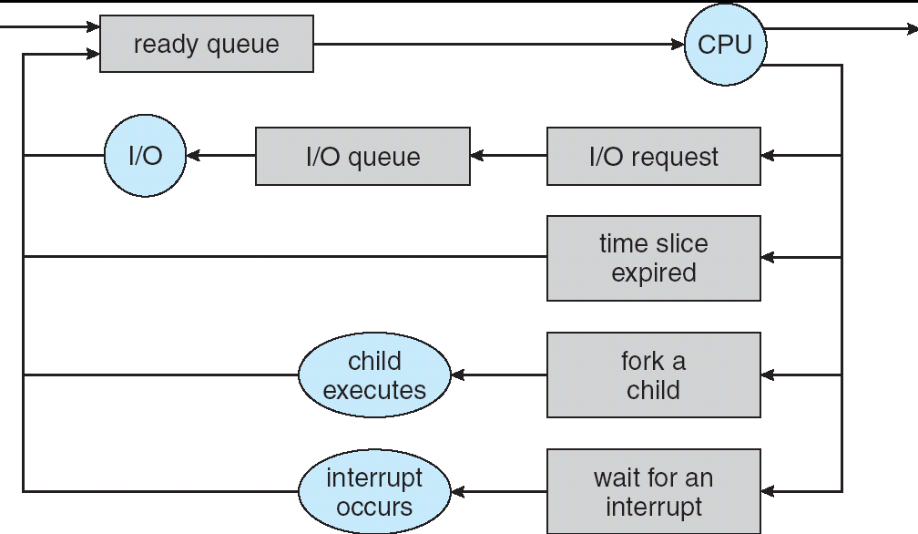
Recall: Scheduling
Question: How is the OS to decide which of several tasks to take off a queue?
Scheduling: deciding which threads are given access to resources from moment to moment
Often, we think in terms of CPU time, but could also think about access to resources like network BW or disk access

Slide 82
Scheduling: All About Queues

Slide 83
Scheduling Assumptions
CPU scheduling big area of research in early 70’s
Many implicit assumptions for CPU scheduling:
One program per user
One thread per program
Programs are independent
Clearly, these are unrealistic but they simplify the problem so it can be solved
For instance: is “fair” about fairness among users or programs?
If I run one compilation job and you run five, you get five times as much CPU on many operating systems
The high-level goal: Dole out CPU time to optimize some desired parameters of system
USER1
USER2
USER3
USER1
USER2
Time

Slide 84
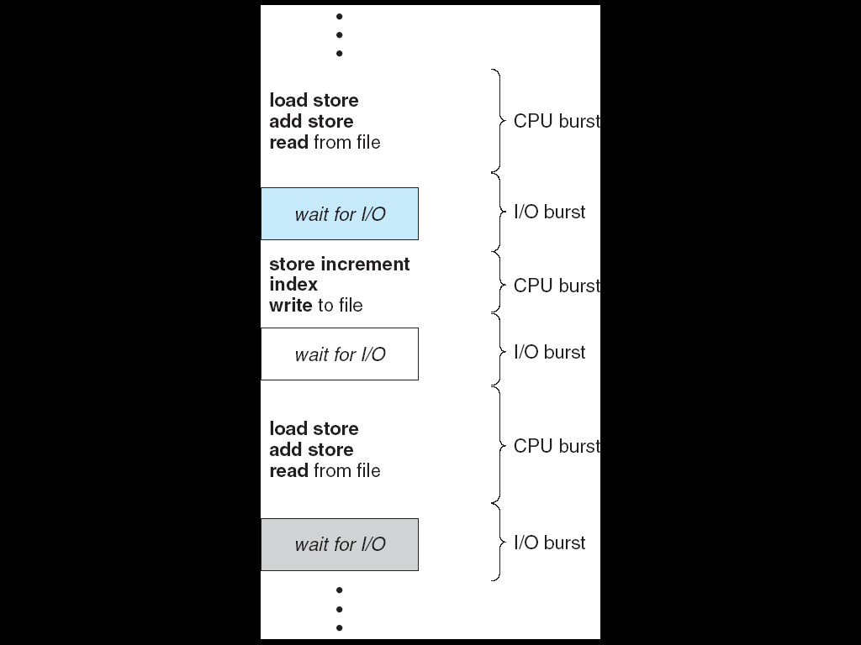
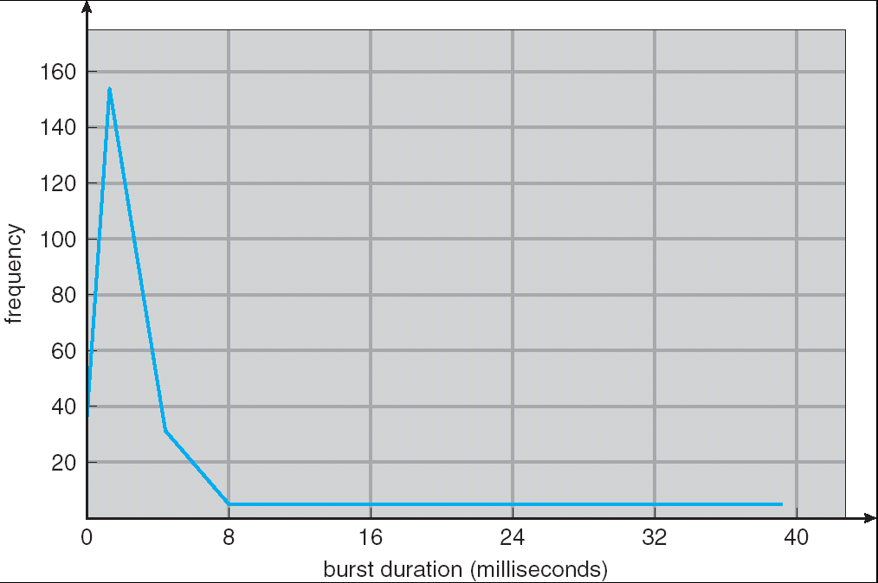
Assumption: CPU Bursts
Weighted toward small bursts
Execution model: programs alternate between bursts of CPU and I/O
Program typically uses the CPU for some period of time, then does I/O, then uses CPU again
Each scheduling decision is about which job to give to the CPU for use by its next CPU burst
With timeslicing, thread may be forced to give up CPU before finishing current CPU burst

Slide 85
Scheduling Policy Goals/Criteria
Minimize Response Time
Minimize elapsed time to do an operation (or job)
Response time is what the user sees:
Time to echo a keystroke in editor
Time to compile a program
Real-time Tasks: Must meet deadlines imposed by World
Maximize Throughput
Maximize operations (or jobs) per second
Throughput related to response time, but not identical:
Minimizing response time will lead to more context switching than if you only maximized throughput
Two parts to maximizing throughput
Minimize overhead (for example, context-switching)
Efficient use of resources (CPU, disk, memory, etc)
Fairness
Share CPU among users in some equitable way
Fairness is not minimizing average response time:
Better average response time by making system less fair
Notes:
What does CPU scheduling have to do with efficient use of the disk?
A lot! Have to have the CPU to make a disk request
Fairness: Minimize # of angry phone calls? Minimize my response time?

Slide 86
First-Come, First-Served (FCFS) Scheduling
First-Come, First-Served (FCFS)
Also “First In, First Out” (FIFO) or “Run until done”
In early systems, FCFS meant one program scheduled until done (including I/O)
Now, means keep CPU until thread blocks
Example: Process Burst Time P₁ 24 P₂ 3 P₃ 3
Suppose processes arrive in the order: P₁ , P₂ , P₃ The Gantt Chart for the schedule is:
Waiting time for P₁ = 0; P₂ = 24; P₃ = 27
Average waiting time: (0 + 24 + 27)/3 = 17
Average Completion time: (24 + 27 + 30)/3 = 27
Convoy effect: short process stuck behind long process
P₁
P₂
P₃
0
24
27
30

Slide 87
Convoy effect
Scheduled Task (process, thread)
time
Scheduling queue
arrivals
With FCFS non-preemptive scheduling, convoys of small tasks tend to build up when a large one is running.

Slide 88
FCFS Scheduling (Cont.)
Example continued:
Suppose that processes arrive in order: P2 , P3 , P1 Now, the Gantt chart for the schedule is:
Waiting time for P1 = 6; P2 = 0; P3 = 3
Average waiting time: (6 + 0 + 3)/3 = 3
Average Completion time: (3 + 6 + 30)/3 = 13
In second case:
Average waiting time is much better (before it was 17)
Average completion time is better (before it was 27)
FIFO Pros and Cons:
Simple (+)
Short jobs get stuck behind long ones (-)
Safeway: Getting milk, always stuck behind cart full of items! Upside: get to read about Space Aliens!
P₂
P₃
P₁
0
3
6
30

Slide 89
Round Robin (RR) Scheduling
FCFS Scheme: Potentially bad for short jobs!
Depends on submit order
If you are first in line at supermarket with milk, you don’t care who is behind you, on the other hand…
Round Robin Scheme: Preemption!
Each process gets a small unit of CPU time (time quantum), usually 10-100 milliseconds
After quantum expires, the process is preempted and added to the end of the ready queue.
n processes in ready queue and time quantum is q ⇒
Each process gets 1/n of the CPU time
In chunks of at most q time units
No process waits more than (n-1)q time units

Slide 90
RR Scheduling (Cont.)
Performance
q large ⇒ FCFS
q small ⇒ Interleaved (really small ⇒ hyperthreading?)
q must be large with respect to context switch, otherwise overhead is too high (all overhead)

Slide 91
Example of RR with Time Quantum = 20
Example: Process Burst Time P₁ 53 P₂ 8 P₃ 68 P₄ 24
The Gantt chart is:
Waiting time for P₁=(68-20)+(112-88)=72 P₂=(20-0)=20 P₃=(28-0)+(88-48)+(125-108)=85 P₄=(48-0)+(108-68)=88
Average waiting time = (72+20+85+88)/4=66¼
Average completion time = (125+28+153+112)/4 = 104½
Thus, Round-Robin Pros and Cons:
Better for short jobs, Fair (+)
Context-switching time adds up for long jobs (-)
P₁
P₂
P₃
P₄
P₁
P₃
P₄
P₁
P₃
P₃
0
20
28
48
68
88
108
112
125
145
153

Slide 92
How to Implement RR in the Kernel?
FIFO Queue, as in FCFS
But preempt job after quantum expires, and send it to the back of the queue
How? Timer interrupt!
And, of course, careful synchronization
Project 2: Scheduling

Slide 93
Round-Robin Discussion
How do you choose time slice?
What if too big?
Response time suffers
What if infinite (∞)?
Get back FIFO
What if time slice too small?
Throughput suffers!
Actual choices of timeslice:
Initially, UNIX timeslice one second:
Worked ok when UNIX was used by one or two people.
What if three compilations going on? 3 seconds to echo each keystroke!
Need to balance short-job performance and long-job throughput:
Typical time slice today is between 10ms – 100ms
Typical context-switching overhead is 0.1ms – 1ms
Roughly 1% overhead due to context-switching

Slide 94
Comparisons between FCFS and Round Robin
Assuming zero-cost context-switching time, is RR always better than FCFS?
Simple example: 10 jobs, each take 100s of CPU time RR scheduler quantum of 1s All jobs start at the same time
Completion Times:
Both RR and FCFS finish at the same time
Average completion time is much worse under RR!
Bad when all jobs same length
Also: Cache state must be shared between all jobs with RR but can be devoted to each job with FIFO
Total time for RR longer even for zero-cost switch!
Job # | FIFO | RR
1 | 100 | 991
2 | 200 | 992
… | … | …
9 | 900 | 999
10 | 1000 | 1000

Slide 95
Earlier Example with Different Time Quantum
P₂
[8]
P₄
[24]
P₁
[53]
P₃
[68]
Best FCFS:
0
8
32
85
153
Quantum
P₁
P₂
P₃
P₄
Average
Wait
Time
Best FCFS
32
0
85
8
31¼
Q = 1
84
22
85
57
62
Q = 5
82
20
85
58
61¼
Q = 8
80
8
85
56
57¼
Q = 10
82
10
85
68
61¼
Q = 20
72
20
85
88
66¼
Worst FCFS
68
145
0
121
83½
Completion
Time
Best FCFS
85
8
153
32
69½
Q = 1
137
30
153
81
100½
Q = 5
135
28
153
82
99½
Q = 8
133
16
153
80
95½
Q = 10
135
18
153
92
99½
Q = 20
125
28
153
112
104½
Worst FCFS
121
153
68
145
121¾

Slide 96
Conclusion
Monitors represent the logic of the program
Wait if necessary
Signal when change something so any waiting threads can proceed
Monitors supported natively in a number of languages
Readers/Writers Monitor example
Shows how monitors allow sophisticated controlled entry to protected code
Round-Robin Scheduling:
Give each thread a small amount of CPU time when it executes; cycle between all ready threads
Pros: Better for short jobs
Next Time: Shortest Job First (SJF)/Shortest Remaining Time First (SRTF):
Run whatever job has the least amount of computation to do/least remaining amount of computation to do
Pros: Optimal (average response time)
Cons: Hard to predict future, Unfair

